Slide 1
Better Together API
Ken Church
Town Hall
Aug 20, 2024

Slide 2
Federated API
Query
(paper id)
Recommendation APIs
Embeddings
Semantic Scholar
Specter
Federated Recommendation API
PubMed (Medicine)
ProNE
ADS (Astronomy)
Recommendations
(paper ids)

Slide 3
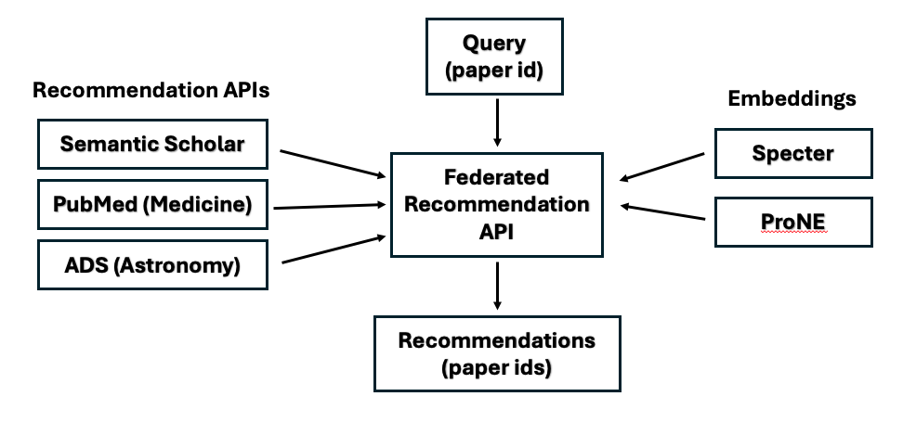
Motivation for a Federated API
Easy to create web sites
https://recommendpapers.xyz
To compare and contrast
Different APIs/Embeddings
Different recommendations are different
Almost no overlap

Slide 4
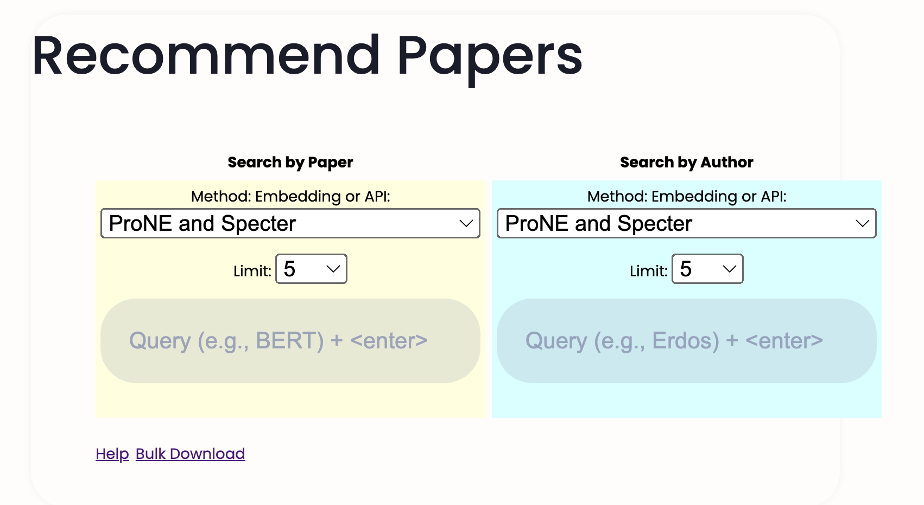
https://recommendpapers.xyz

Slide 5
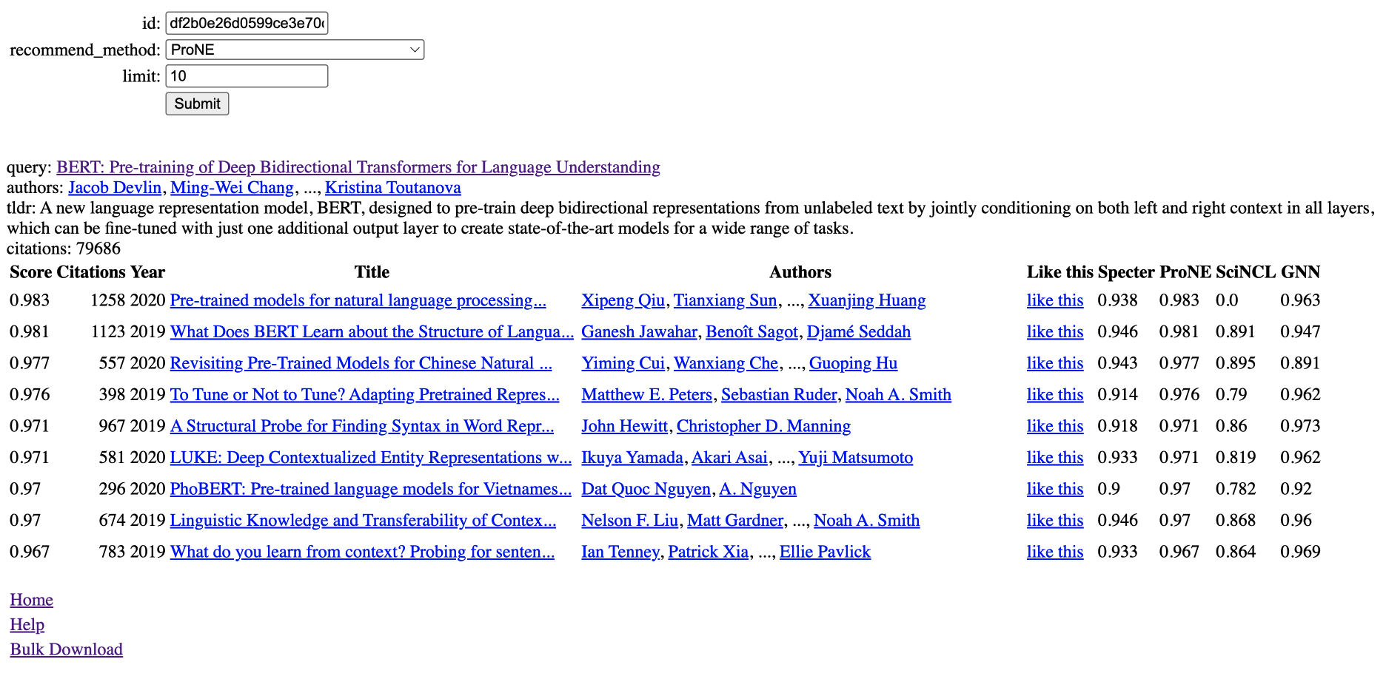

Slide 6
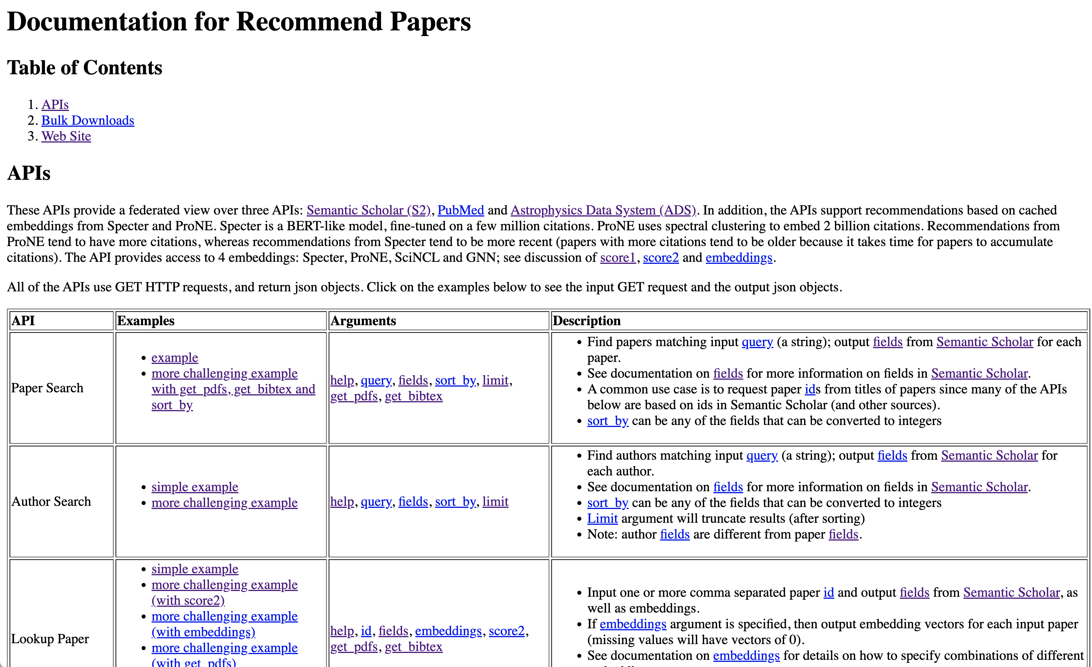
API Documentation

Slide 7
10 Entry Points
Paper Search:
Input query (strings); output papers ids
Author Search:
Input query (strings); output author ids
Lookup Paper:
Input paper ids; output fields (titles, abstracts, embeddings, etc.)
Lookup Author:
Input author ids; output fields (titles, abstracts, embeddings, etc.)
Lookup Citations:
Lookup Citations for paper id and output fields from Semantic Scholar for each citation
Coauthors:
Input a query (a string); output a list of coauthors (filtered by after_year) for each matching author id.
Recommend Papers:
Input a paper id and a recommendation method;
output paper ids (with fields, scores, etc.)
Recommend Authors:
Input an author id and a recommendation method;
output paper ids (with fields, scores, etc.)
Compare and contrast papers with chatbot/RAG
Compare and Contrast texts with chatbot/RAG

Slide 8
Use Case: Assign Papers to Reviewers
Had a very promising call with a NASA PM Megan Ansdell
It takes her about a week to put together a panel
She needs to find reviewers that
are qualified
diverse over experience, etc.
avoid conflicts of interest
She can program in Python (and use these APIs)
She wrote a tool to check proposals for anonymity (pronouns)
Many of her peers are more senior than she is
So she runs her tool on their proposals
We talked about a sole source grant, so we could work together on this use case
More generally, I would like to scale this up to large conferences

Slide 9
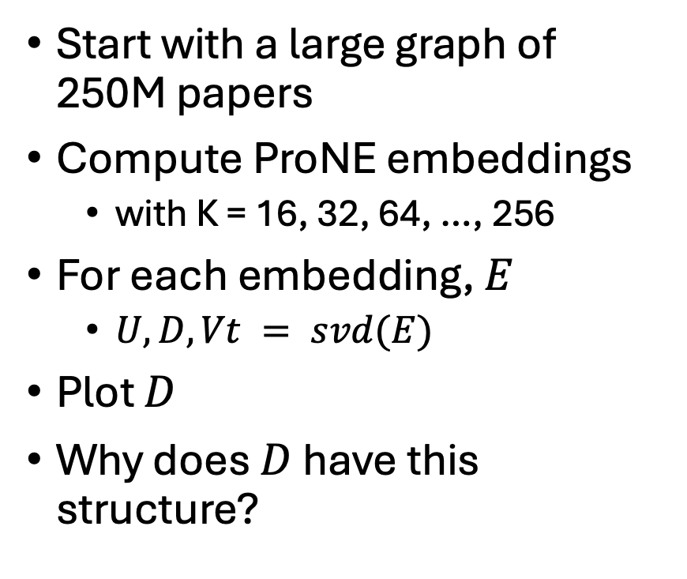
Eigenvalues by K (# Hidden Dimensions)
Start with a large graph of 250M papers
Compute ProNE embeddings
with K = 16, 32, 64, …, 256
For each embedding, $E$
$U, D, Vt = svd(E)$
Plot $D$
Why does $D$ have this structure?

Slide 10
Eigenvalues by Bin

Slide 11
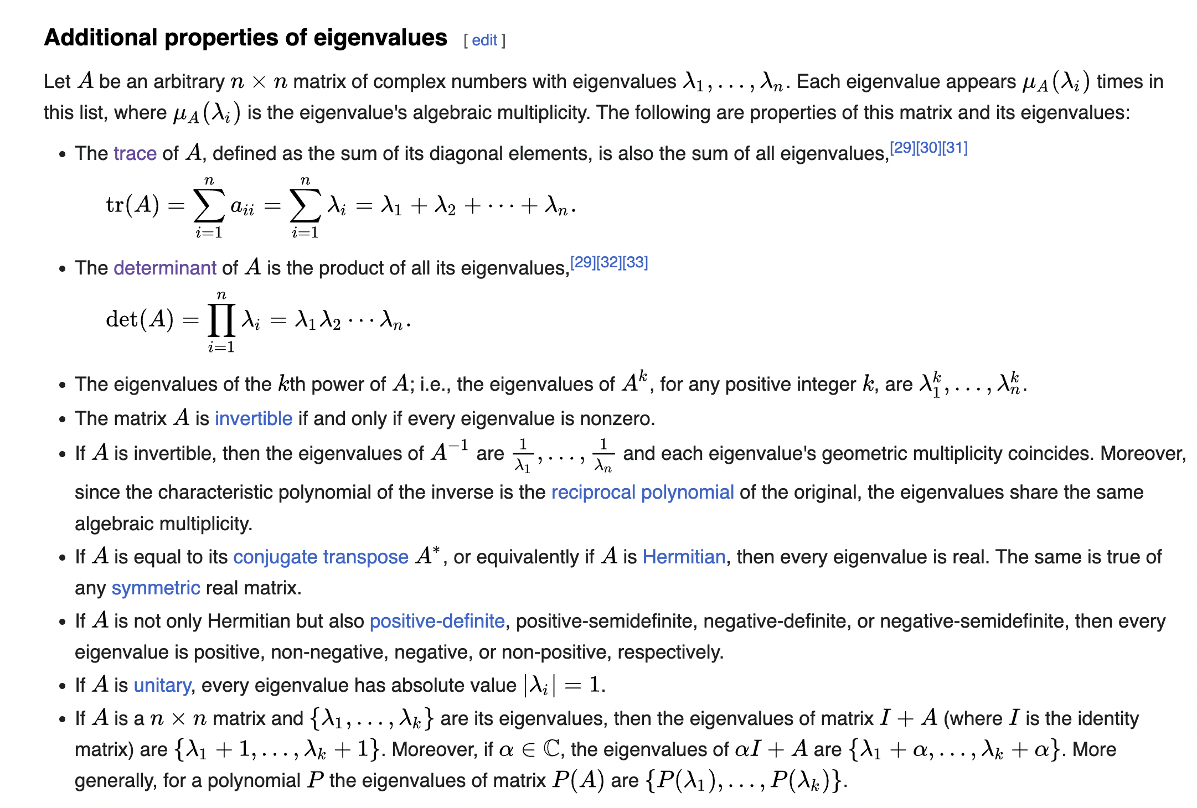
https://en.wikipedia.org/wiki/Eigenvalues_and_eigenvectors

Slide 12
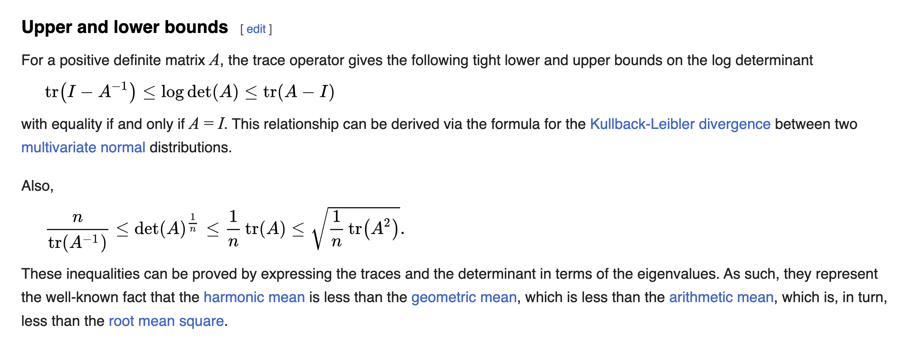
https://en.wikipedia.org/wiki/Determinant

